Slide 1

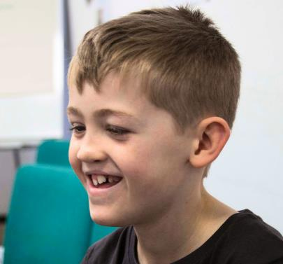

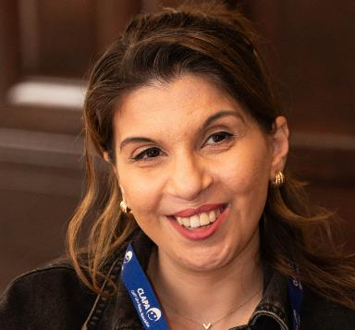
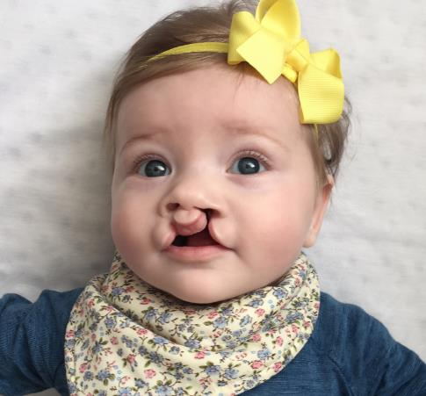

All About
Cleft Lip
and Palate
For schools
Registered Charity England & Wales (1108160) and Scotland (SC041034)
Notes:
Remember to stand, take a deep breath, and introduce the charity and yourself. You do no need to rush; start your presentation calmly and pace yourself.

Slide 2
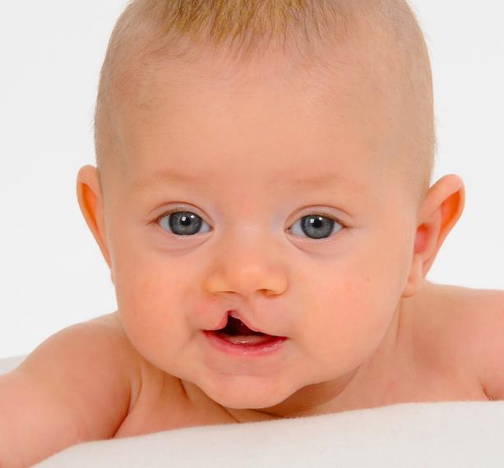
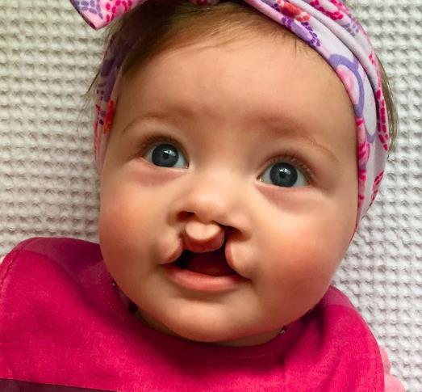
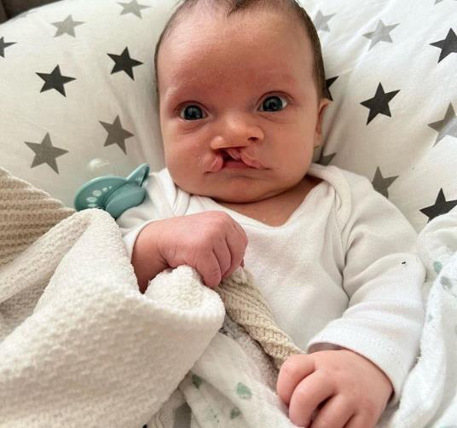
What is cleft lip and palate?
Cleft lip: gap in top lip
Cleft palate: gap in roof of the mouth
Registered Charity England & Wales (1108160) and Scotland (SC041034)
Notes:
Ask your audience: Put your finger just above your top lip - can you feel a little dip right under your nose?
Before we're born, different parts of our face grow separately and then join together in the middle, right below our nose.
Sometimes, these different parts don't come together all the way.
When this happens, a little gap is left. This is called a 'cleft'.
A cleft lip is one or two gaps in your upper lip.
The roof of your mouth is called your 'palate'. A cleft palate is when you have a gap in the roof of your mouth.
A baby with a cleft may look a little different, but it doesn't hurt them. They don't know anything is different about them.

Slide 3
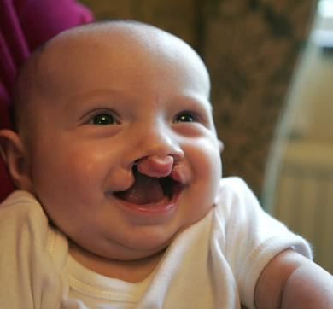
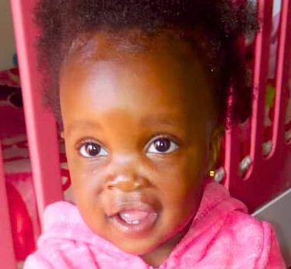
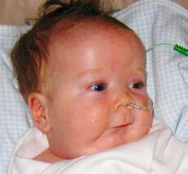
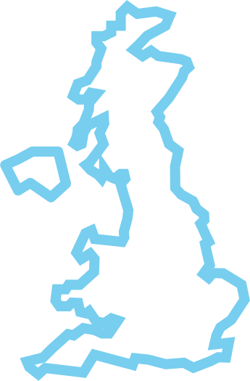

One in 700 babies is born with a cleft
That’s three every day in the United Kingdom!
Registered Charity England & Wales (1108160) and Scotland (SC041034)
Notes:
All over the world, around one in 700 babies is born with a cleft.
That's three babies every single day in the UK.
A cleft can happen for lots of different reasons. Sometimes, it runs in the family. Sometimes, it's just random chance.

Slide 4
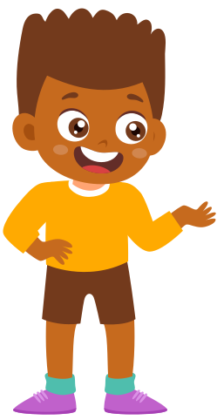
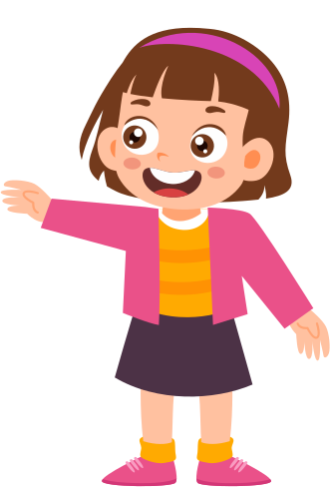
What is it like to have a cleft?
It’s harder to make some sounds when talking
You might sound ‘nasal’, or like you have a cold
Registered Charity England & Wales (1108160) and Scotland (SC041034)
Notes:
Everyone born with a cleft is different, so they'll be affected in different ways.
TALKING
When we talk, the muscles at the back of our mouth move around to change how much air goes through our nose.
Demonstration:
For sounds like 'M', air comes through our nose. For sounds like 'B' ('buh buh buh'), air comes through our mouths.
If you have a cleft palate, a gap in the roof of your mouth, it's really hard to do this, so making some noises can be hard too. That's why people with a cleft palate might sound different.
They might find it hard to make some sounds. They might have too much air coming through their nose, so they sound 'nasal'. Or they might sound 'muffled', like they have a cold.

Slide 5
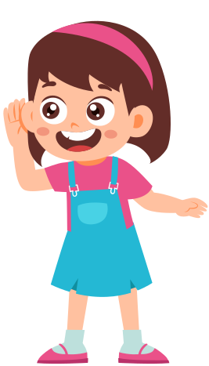
What is it like to have a cleft?
Our ears, throat and mouth are connected.
A cleft palate makes you more likely to have hearing issues.
Registered Charity England & Wales (1108160) and Scotland (SC041034)
Notes:
HEARING
When you yawn or when your ears pop, you might feel how your ears, throat and mouth are connected.
If you have a cleft palate, you're more likely to have problems with your hearing, so you might need hearing aids or other help.

Slide 6
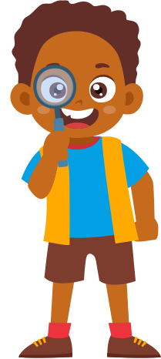
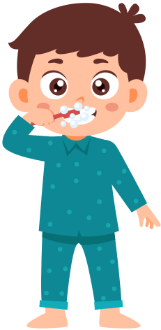
What is it like to have a cleft?
You might have a gap in your gum and missing teeth.
Registered Charity England & Wales (1108160) and Scotland (SC041034)
Notes:
TEETH
If you have a cleft lip, you might also have a gap in your gum, which means you might be missing one or two teeth.
You might also need braces before your friends, and might need an operation to help your adult teeth come through properly.

Slide 7
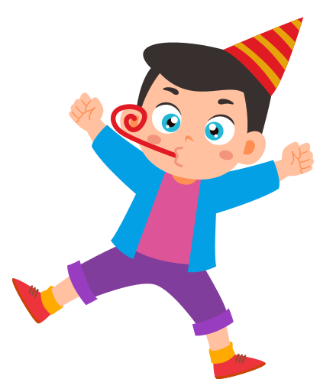
What is it like to have a cleft?
Could you drink through a straw with a hole in the side?
It can be extra hard to drink, blow balloons, or use wind instruments.
Registered Charity England & Wales (1108160) and Scotland (SC041034)
Notes:
Imagine if you were trying to drink through a straw, but there was a hole in the side. What would happen?
You'd have to work really hard! You might not even be able to get any of your drink.
When a baby is born with a cleft, they can't make a 'vacuum' with their mouths; they need lots of help to drink milk. Even after their operation, it can still be very difficult for children to drink through straws, or blow up balloons, use wind instruments, or anything like that.

Slide 8
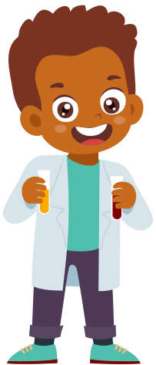
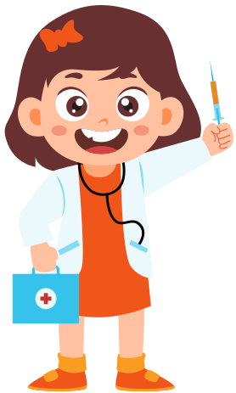
What is it like to have a cleft?
You might have lots of hospital appointments and operations
Registered Charity England & Wales (1108160) and Scotland (SC041034)
Notes:
Being born with a cleft means you have to go to lots of hospital appointments.
You need to see lots of different kinds of doctors to make sure your hearing, speaking, teeth, and any other issues are looked after.
You might also need extra operations. Some people born with a cleft will have over 20 operations by the time they're an adult!

Slide 9
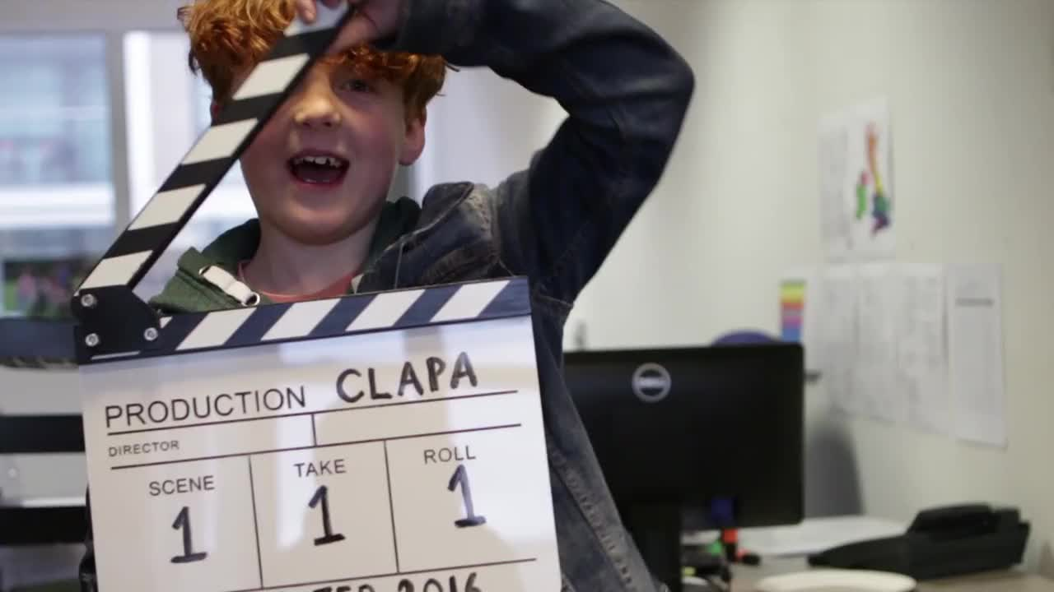
Registered Charity England & Wales (1108160) and Scotland (SC041034)
Notes:
This short video shows people born with a cleft explaining what it's like and why getting support and understanding is so important.
[Remove slide if sound isn't available]

Slide 10
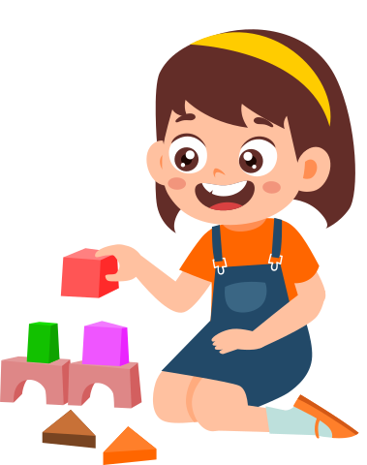
Everyone is different!
What’s unique about you?
What would the world be like if we were all the same?
How should we treat people
who are different?
Registered Charity England & Wales (1108160) and Scotland (SC041034)
Notes:
[OPTIONAL SLIDE - Edit contents to fit age range and class topics]
Everyone is different; we all have things that make us unique.
Sometimes these are things we're born with, sometimes these are things we get as we grow up.
What's unique about YOU?
What would the world be like if we were all the same?
When we meet people who have things that are different or unique about them, how should we treat them?
[Talk to the class about kindness, understanding, and empathy. How would they feel if they were treated badly for something they couldn't control? You might also want to talk about how they might be curious, but to be sensitive when asking questions.]

Slide 11
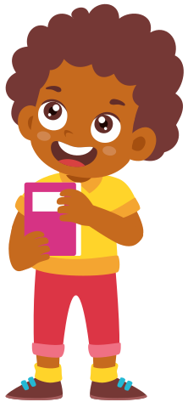
My Story
Add photos or text
Registered Charity England & Wales (1108160) and Scotland (SC041034)
Notes:
[OPTIONAL SLIDE - Add photos or text to share the story of a young person in the class with their permission]
[You can use one of these templates to help: https://www.clapa.com/awareness-week/tell-your-story/#templates]

Slide 12
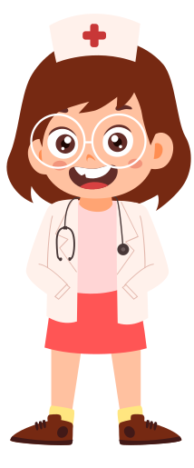
How would you feel?
If you had to go into hospital for an operation, how would you feel?
What would you like to bring?
Who would you like to visit you?
What would make you feel better
when you came back to school?
Registered Charity England & Wales (1108160) and Scotland (SC041034)
Notes:
[OPTIONAL SLIDE - Edit contents to fit age range and class topics]
Being born with a cleft means you might have to have lots of operations.
If you had to go to hospital to have an operation, how would you feel?
What kind of things would you want to bring with you?
Who would you like to visit you?
What would make you feel better when you came back to school?

Slide 13
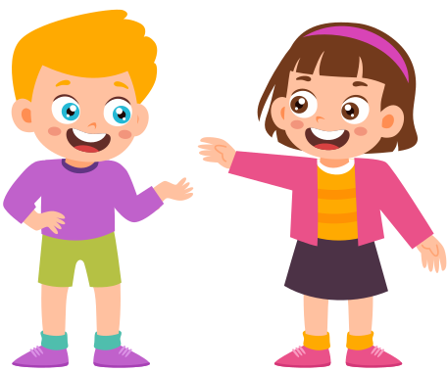
How can you help?
Be kind to people who look or sound different to you.
Tell other people what
you’ve learnt today!
Registered Charity England & Wales (1108160) and Scotland (SC041034)
Notes:
How can you help?
Firstly, remember to be kind to people who look or sound different to you.
Each and every one of us is different, not just in who we are, but in how we look and how we sound. Be kind to people who are different to you, and treat everyone you meet just as you would like them to treat you.
Secondly, tell your friends or family about what you've learnt today!
What is one fact about cleft that you'll remember?
(Suggest - Three babies born with a cleft every day in the UK)

Slide 14
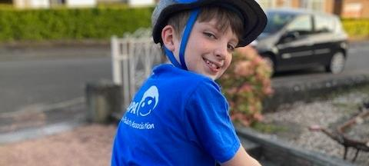
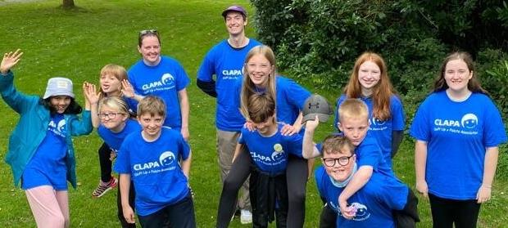
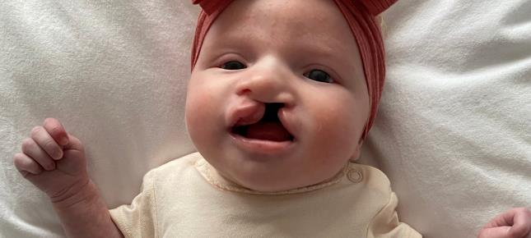
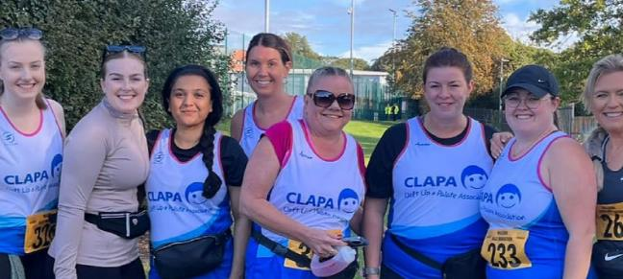
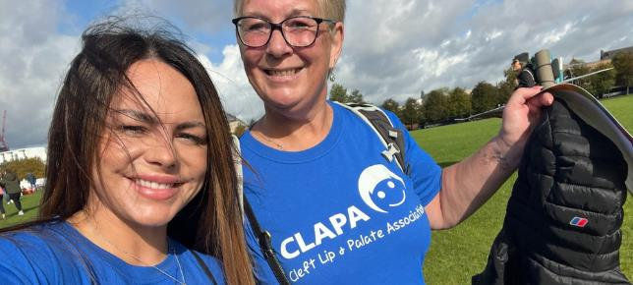
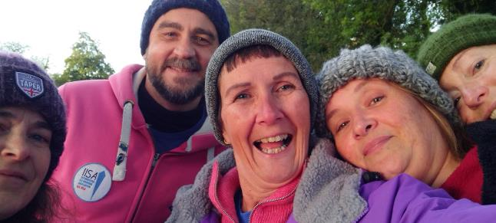
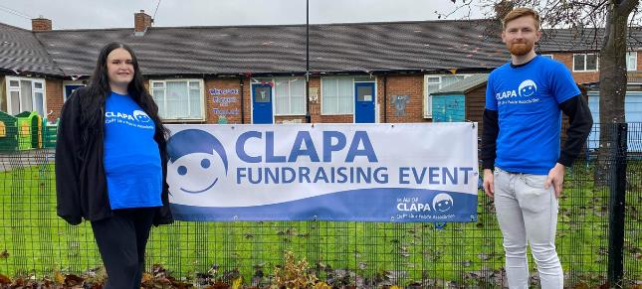
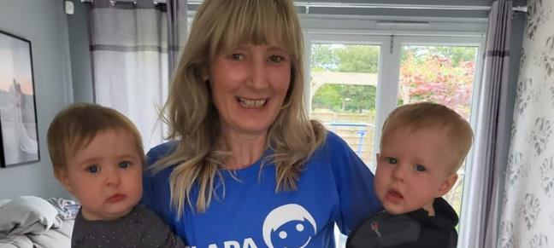
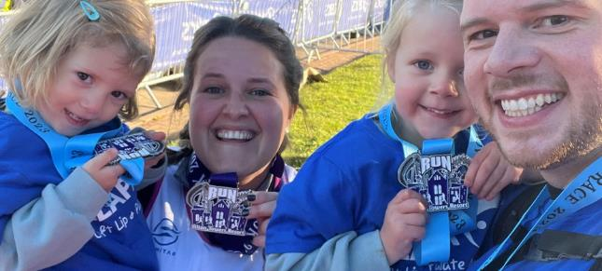
What is CLAPA?
Notes:
[OPTIONAL SLIDE - include this if you're doing fundraising]
CLAPA is a charity which supports people in the UK affected by cleft lip and palate.
They send out special bottles when babies are born and support families at every step of their journey. They also support children, teenagers and adults, and help them to feel happier and more confident.
We're raising money to help make sure that no one born with a cleft in the UK has to deal with it on their own.
[Talk about the fundraising activity]

Slide 15
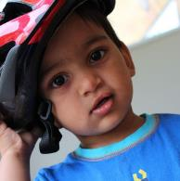
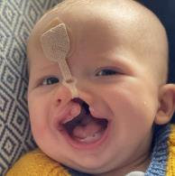
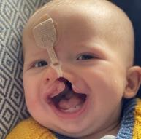
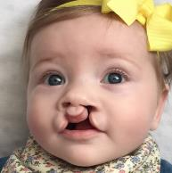
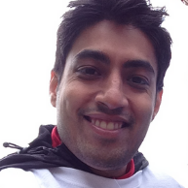
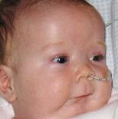
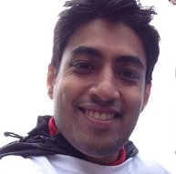

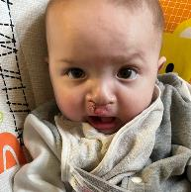
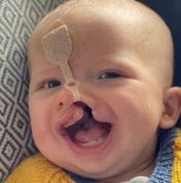

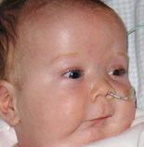
Thank You!
Notes:
[OPTIONAL SLIDE - include this if you're doing fundraising]
CLAPA is a charity which supports people in the UK affected by cleft lip and palate.
They send out special bottles when babies are born and support families at every step of their journey. They also support children, teenagers and adults, and help them to feel happier and more confident.
We're raising money to help make sure that no one born with a cleft in the UK has to deal with it on their own.
[Talk about the fundraising activity]

