Slide 1
Notes:
Remember to stand, take a deep breathe, and THEN introduce the charity and yourself. There is no rush, make sure you start your presentation calmly, and pace yourself. Speak nice and clearly.
Introduce yourself and CLAPA
1 minute

Slide 2
Notes:
Refer to the photos on the slide to explain that the baby may look a little different, but that it doesn’t hurt. In very simple terms, cleft means ‘a gap’.
When a baby is growing in their mummy’s tummy, different parts of their face start growing separately, then join together in the middle, just below their nose. Most people have a little dip in the middle of their top lip – can you feel yours?
For one in every 700 babies, the different parts of their face don’t come together all the way. So they have a gap, called a ‘cleft’, in their lip or the top of their mouth.
There are lots of different reasons why this might happen. No one knows exactly why.
Get the children to push their tongue against their upper mouth, and touch their lips, explain that a cleft palate would be in the roof of their mouth and ac left lip would be a gap in their lip
3min

Slide 3
Notes:
Time for the straws! – ask for some volunteers
Firstly get the children to try and drink water with the straw without holes – did they have any difficulties? Now get them to try with the straws with the holes. Can they do it?
Talk about when a baby is born with a cleft, they aren’t able to feed properly. Most babies with a cleft palate can’t form a ‘vacuum’ with their mouths, so they can’t suck from a bottle. It’s like trying to use a straw that’s full of holes.
3min

Slide 4
Notes:
Introduce the cartoon and explain that it’s going to tell the children a bit more about cleft and famous people born with cleft lip or palate
1 min

Slide 5
Notes:
The child will need to have an operation when they are very young – usually around three to six months to repair the lip, and then the palate is usually repaired within 6-12 months of birth.
Most babies recover very quickly and will not experience much pain after these operations – it can be a hard time for mums and dad’s and any brothers and sisters because there is a lot of changes to adjust.
Ask the children: does anyone have any ‘adult’ teeth yet?
Explain that if there is a gap in the baby’s gums, this will be repaired as their adult teeth are coming through with a further operation at around 8-12 years old.
Explain that the child may grow up to have a scar, and as well as their mouth, their nose may also look different. They could also:
Lots more operations
Hearing problems
Speech problems
3min

Slide 6
Notes:
Introduce the clip of Aleisha on BBC Midlands Today!
3min

Slide 7
Notes:
Introduce the clip and that it talks about bone grafts. Possibly mention that Aleisha had hers recently
4 min

Slide 8
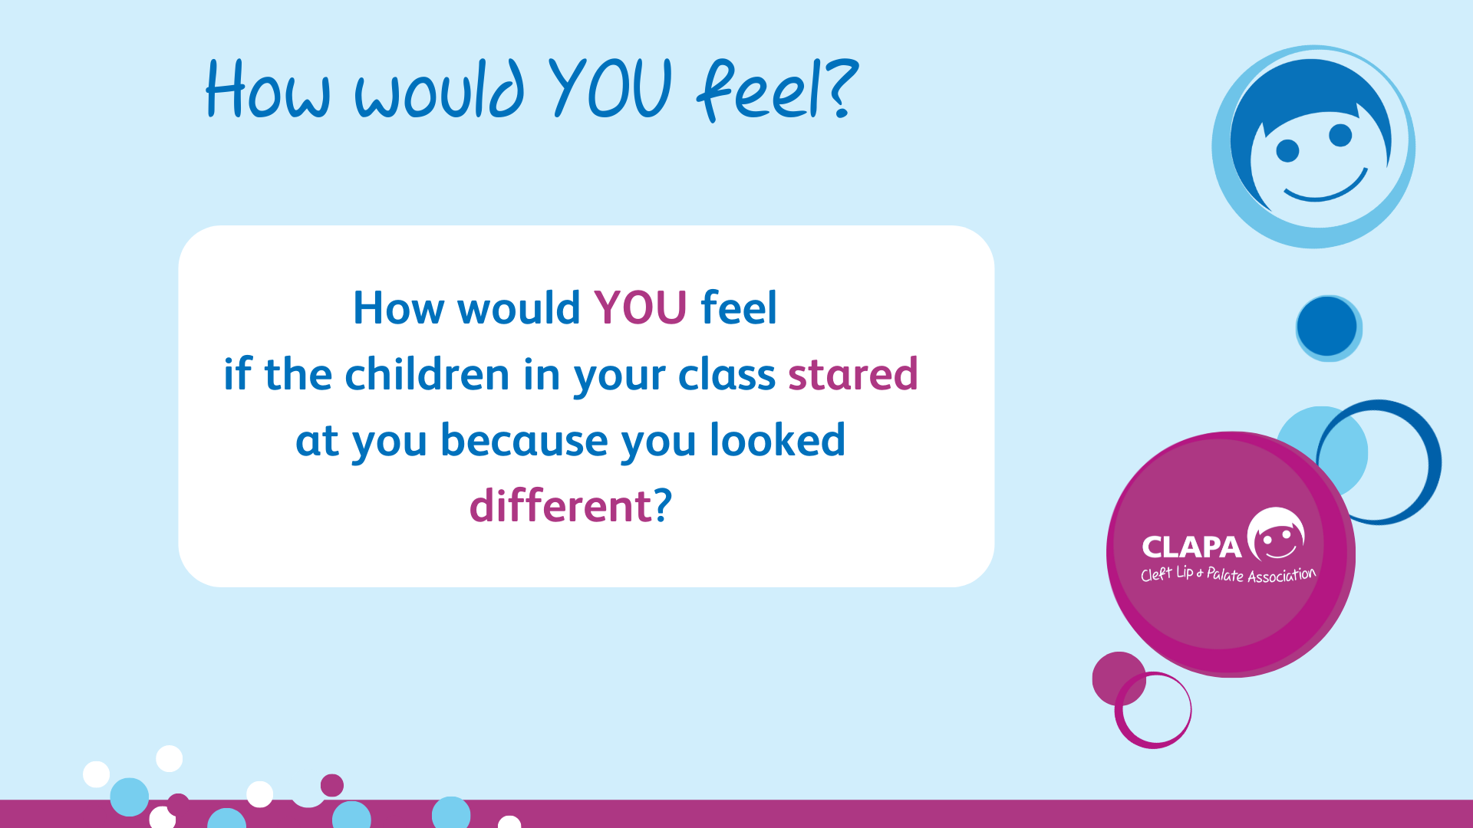
Notes:
Ask the children: How would you feel if the other children in your class stared at you because you looked different?
Follow up and ask the children: Sometimes people do sound or look different to us, but they might not want stand out.
1 min

Slide 9
Notes:
CLAPA
Send special bottles to new babies born with a cleft
Run events for children and their families
Run confidence building adventure weekends for young people
Have lots of information about cleft on the CLAPA website
Help children, young people, families and adults to make friends so they know they are not alone

Slide 10
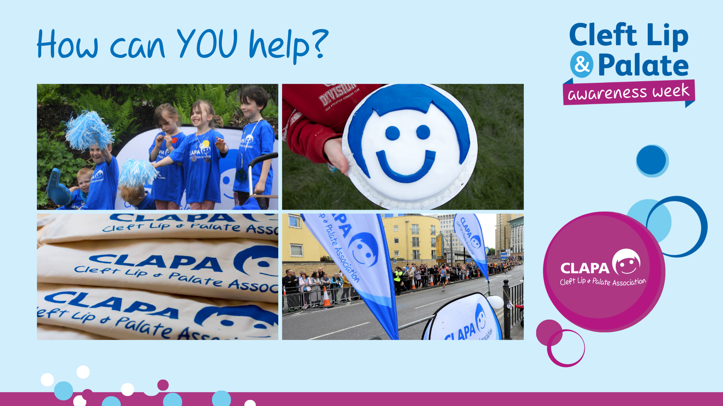
Notes:
WAYS TO HELP CLAPA
There are LOTS of ways to help CLAPA! Our top three are:
NUMBER 1
Each of us looks and sounds very different. Please treat everyone in your school and who you meet outside of school, just as you would like them to treat you!
NUMBER 2
Tell your mums, dads, friends, brothers and sisters etc. about CLAPA and what you learnt about cleft lip today – we’re sure they would be very happy to hear about what you have been up to this morning/afternoon!
NUMBER 3 - FUNDRAISE
CLAPA is able to do all of the amazing things it does, because of the wonderful support of volunteers who help to fundraise. Here are some of the ways that schools help:
Cake sales- yummy buns! (like Aleisha did)
Talent shows
Sponsored activities like silences, fancy dress, sports days etc.
Additional Information – don’t need to include, but in case teachers ask:
£1,000 – 50 places at a local family day
£300 – 10 places on an activity day for young people
£170 – 1 young person to attend a confidence-building residential
£20 – 1 welcome pack for a new family
2 min

