Slide 1
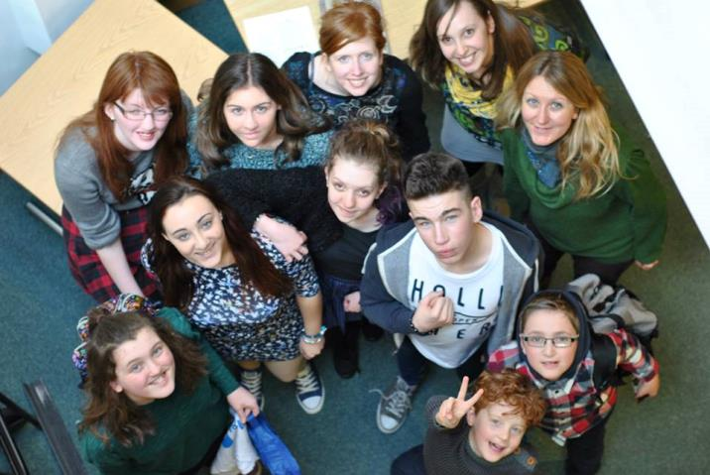
Helping Children with a Cleft Succeed at School
Notes:
H

Slide 2
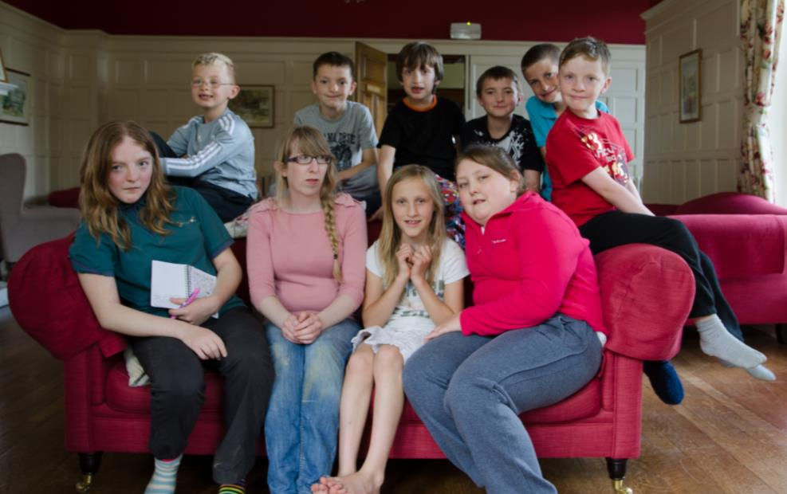
https://vimeo.com/194534479

Slide 3
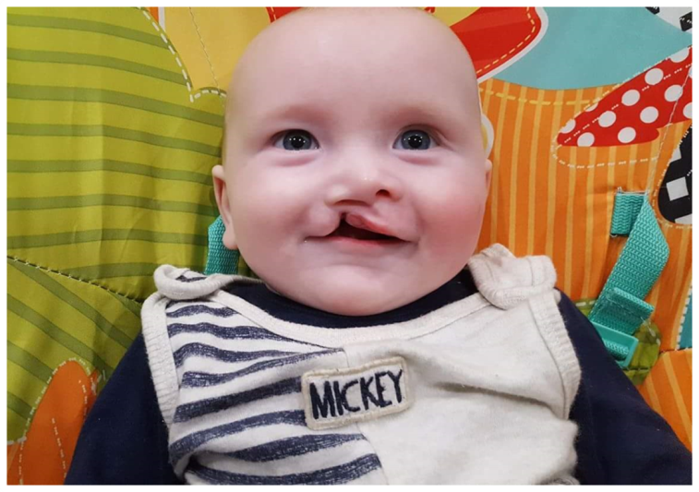
What is cleft lip & palate?
‘Cleft’ just means ‘gap’
A ‘cleft lip’ is a gap in the upper lip.
A ‘cleft palate’ is a gap in the top of the inside of the mouth.
Notes:
1 in 700 babies are born with a cleft. That’s around 100 every month in the UK alone.
In early pregnancy, different parts of a baby’s face develop separately and then join together just above the top lip. If they don’t join properly, the baby is born with a gap or ‘cleft’. This gap can be on one or both sides of their lip (cleft lip), in the roof of their mouth (cleft palate), or both. There’s no single cause of cleft. It can happen in any pregnancy and it’s no one’s fault.
Babies born with a cleft have one or more surgeries to close these gaps before their first birthday. Comprehensive treatment into adulthood is provided by NHS Cleft Teams.
Like every child, every cleft is unique.

Slide 4
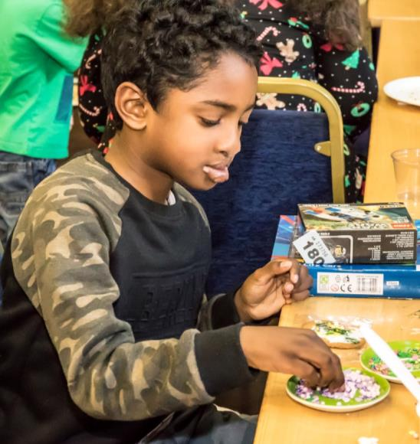
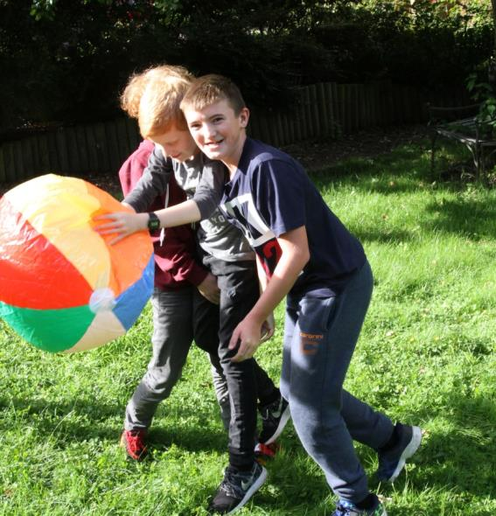
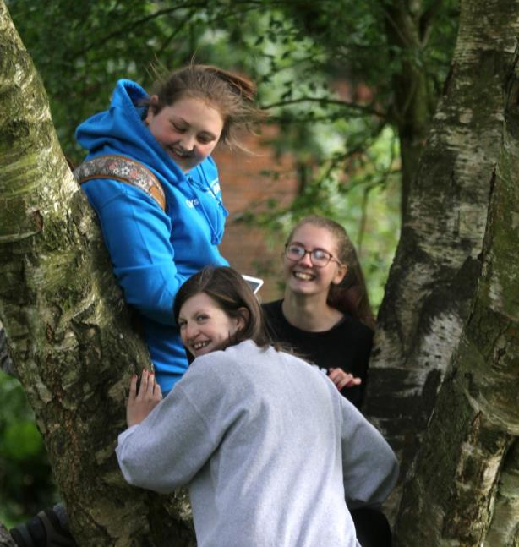
Growing up with a cleft lip and/or palate
Notes:
This presentation is intended to help teachers understand some of the issues that a child born with a cleft might face, and what they can do to help.
It’s important to note that many children will not want to draw attention to themselves or their cleft, and any interventions which involve the rest of the class should be carefully discussed with the child and their parents first.

Slide 5
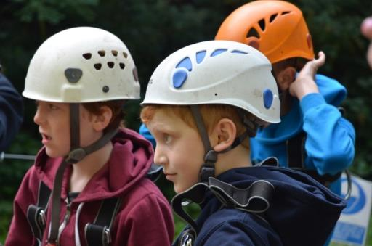
FAQs
Q: Is cleft a disability?
Q: Is cleft linked to learning difficulties?
Q: How do children cope with looking or sounding different?
Notes:
A: No. Children may need extra help with speech and/or hearing issues, but with the right support there’s no reason why they can’t participate fully in education and society.
A: A cleft on its own is a physical issue which does not affect the brain or cognitive development. Children with a cleft may look or sound a little different to their classmates, but most are not affected by any other condition and are just as capable as any other child.
A: Each cleft is unique, just like every child, and how they cope will vary. It usually doesn’t depend on how ‘obvious’ their difference is – sometimes children with minor differences will be more anxious because other people’s reactions can be unpredictable.

Slide 6
Missing School
Even if a child’s cleft doesn’t cause any problems at school, they will likely still have to miss lessons to attend cleft clinic and hospital appointments
How Can Schools Help?
Adapt attendance reward policy so it doesn’t exclude pupils absent for medical reasons. Instead of ‘100% attendance’, they could reward ‘maximum possible’ or ‘most improved’ attendance.
Work with parents to make sure children are given a chance to catch up.
Notes:
Even if a child’s cleft doesn’t cause any problems at school, they will likely still have to miss lessons to attend cleft clinic and hospital appointments. It’s usually not possible to arrange appointments for specific times outside of school hours.
If they need regular treatment such as speech and language therapy, they may need to come out of class more frequently.
This can lead to children missing out on attendance awards, or even receiving warning letters about ‘persistent absence’, even when absences are authorised.
How Schools Can Help
Adapt their attendance reward policy so it doesn’t exclude pupils absent for medical reasons.
Instead of ‘100% attendance’, they could reward ‘maximum possible’ or ‘most improved’ attendance. Teachers should also work with parents to make sure children are given a chance to catch up on any work they’ve missed, and aren’t blamed for their absence.

Slide 7
Appearance Concerns
Some children may feel especially self-conscious about their appearance, and this can have a negative impact on their general confidence levels and class participation.
How Can Schools Help?
Teachers should take extra care to look out for teasing or comments around appearance, and should support children who wish to explain to the rest of the class why they may look different.
They should also sensitively approach any lessons which may bring up issues to do with a child’s cleft or appearance, e.g. self-portraits.
Notes:
Children with a cleft lip may have:
A visible scar
An irregular-shaped nose and lip
A ‘flat’ profile
Missing or crooked teeth (often requiring braces before their peers)
Some children may feel especially self-conscious about their appearance, and this can have a negative impact on their general confidence levels and class participation.
How Schools Can Help
If a child is particularly conscious about their appearance, teachers should take extra care to look out for teasing or comments around this, and should support children who wish to explain to the rest of the class why they may look different.
They should also sensitively approach any lessons which may bring up issues to do with a child’s cleft or appearance, e.g. self-portraits.

Slide 8
Speech Problems
Around 40% of children with a cleft palate being treated for speech issues will still not have ‘normal’ speech by the time they start school, and may sound nasal or be hard to understand. This can affect class participation and social interaction with other children.
Avoid interrupting or ‘correcting’ a child’s speech. This can cause anxiety around speaking.
Ask a child to repeat themselves once. If you still can’t understand, repeat back clearly what you think they may be saying until an understanding is reached.
Notes:
Around 40% of children with a cleft palate being treated for speech issues will still not have ‘normal’ speech by the time they start school, and may sound nasal or be hard to understand.
Sounding different can make a child feel self-conscious about their voice and they may avoid talking as a result. This can affect class participation and social interaction with other children.
A child who finds it difficult to be understood by their peers may become physical in their attempts to communicate, or may be easily frustrated by the need to repeat themselves.
How Schools Can Help
Teachers who find it hard to understand children should avoid interrupting or ‘correcting’ their speech as this can cause feelings of anxiety around talking. If they have to ask the child to repeat themselves, they should do this only once, and if they are still having trouble they should then repeat back clearly what they think the child is trying to communicate until an understanding is reached.

Slide 9
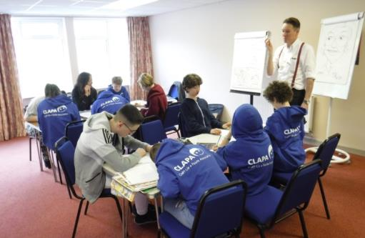
Speech Problems
Certain lessons may cause problems for children with speech difficulties caused by a cleft palate, such as music (especially with wind or brass instruments), languages (children may not be able to physically pronounce certain sounds), and reading out loud.
Teachers should:
Be patient
Encourage children to use their voices
Praise successes and milestones
If possible, work in partnership with parents and a child’s Speech and Language Therapist to support their therapy targets
Notes:
How Schools Can Help cont.
Certain lessons may cause problems for children with speech difficulties caused by a cleft palate, such as music (especially with wind or brass instruments), languages (children may not be able to physically pronounce certain sounds), and reading out loud.
Teachers should be patient, encourage children to use their voices, and praise their successes and milestones. If possible, teachers should work in partnership with parents and a child’s Speech and Language Therapist to support their therapy targets.

Slide 10
Hearing Problems
Children born with a cleft palate may have recurring glue ear.
This happens gradually, so children may not notice anything is wrong, and may seem as though they’re not paying attention.
Look out for problems like this and alert parents if they suspect anything.
It can help to sit the child somewhere in the room where they can clearly see the teacher’s face.
Special allowances may need to be made for examinations that involve listening to tape recorders in large rooms.
Notes:
Children born with a cleft palate may have recurring glue ear, and as this can develop gradually they may not realise there is anything wrong. As a result, children may not seem to be paying attention, their comprehension levels may be low, or they may become more physical in their attempts to see people’s faces and lip-read.
How Schools Can Help
Teachers should look out for problems like this and alert parents if they suspect anything. It can help to sit the child somewhere in the room where they can clearly see the teacher’s face.
Special allowances may also need to be made for examinations that involve listening to tape recorders in large rooms.

Slide 11
Low Self-Esteem
Looking or sounding different can affect how children participate or behave in class as well as how they do academically.
Being aware of these issues is the first step towards managing them.
Ensure that groups for activities are chosen by some other means than popularity or friendship groups.
Recognise a child’s abilities and good qualities, and encourage them in focusing on and developing these. These may even be simple things like being compassionate or enthusiastic.
Notes:
Children who look and/or sound different may have low expectations of themselves and believe that others do too. This can affect how they participate or behave in class and at break times, as well as how they do academically. They may behave in ways that can be seen as disruptive, such as refusing to do tasks or becoming aggressive, or they may become more insular.
How Schools Can Help
Making teachers aware of these issues is the first step towards managing them. There are a number of strategies that might help. For example, teachers could ensure that groups for activities are chosen by some other means than popularity or friendship groups.
Recognising a child’s abilities and encouraging them in focusing on and developing these can be a big help. Children often become aware of these abilities for the first time by having it named and being able to talk about it, even if these abilities are simple things like being compassionate or enthusiastic.

Slide 12
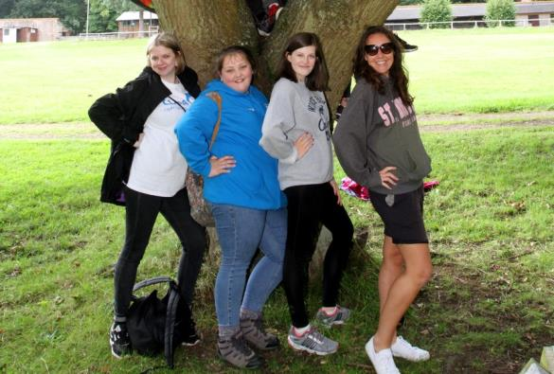
Questions from Others
Children may get questions and comments from classmates about their cleft.
Even when these are well-meaning, they may be upsetting .
Have a basic understanding of cleft and be ready to step in with a simple explanation when necessary. To minimise embarrassment, treat it like any other trait a child might be born with, like eye colour.
If you think it would help, encourage children to come up with a simple way to explain their difference to others who ask, e.g. ‘I was born with a hole in my lip but doctors sewed it up when I was a baby.’
Notes:
Children with a cleft may get questions and comments from classmates about issues to do with their cleft. Even when these are well-meaning, they may be upsetting for children who don’t know how to answer, or who are particularly sensitive to others noticing their difference.
How Schools Can Help
Teachers having a basic understanding of cleft lip and palate and being able to step in when necessary with a simple explanation can be a big help. Treat it like any other trait a child might be born with, such as eye colour, to avoid them feeling embarrassed. You may want to mention their bravery at dealing with surgery and hospital appointments. If you think it would help, encourage children to come up with a simple way to explain their difference to others who ask, e.g. ‘I was born with a hole in my lip but doctors sewed it up when I was a baby.’

Slide 13
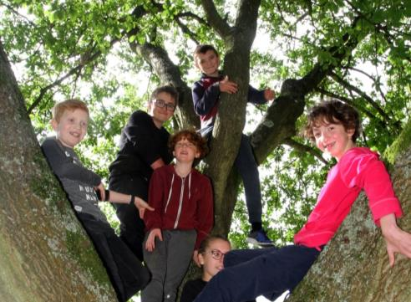
Discussion Points around Cleft
Having a child with a cleft in the class is a good chance to talk to pupils about diversity, acceptance, and empathy.
Here are a few ideas:
Q. Everyone is made differently. Ask pupils to name one thing that is different about them.
Q. Ask the class to think about what the world would be like if we were all the same, and then about the benefits of us all being different.
Q: Ask the class to think about the most important qualities in a friend. Pick out when they focus on things that are to do with someone’s personality, not how they look or sound.
Notes:
Having a child with a cleft in the class is a good chance to talk to pupils about diversity, acceptance, and empathy.
If you have a child in your class who is comfortable talking about cleft, you may wish to do a lesson around what it is, and invite them to share their story. Some children may be more comfortable if they share their story as part of a wider theme of differences, or even as part of a fundraising effort.
CLAPA suggests using the below discussion points to help to cover how we are all different in our own way.
Q. Everyone is made differently. Ask pupils to name one thing that is different about them.
Q. Ask the class to think about what the world would be like if we were all the same, and then about the benefits of us all being different.
Q: Ask pupils to think about someone else in the class – what differences and similarities do they have with one another, and how does this change their relationship?
Q: Ask the class to think about why people might have medical treatment or surgery (e.g. injuries, health reasons, appearance, etc.). How would they feel if they needed an operation? What would they bring with them to the hospital? Who would they like to visit them?
Q: Ask the class to describe the person next to them in three words that have nothing to do with their appearance (e.g. funny, kind, loves dancing)
Q: Ask the class to think about the most important qualities in a friend. Pick out when they focus on things that are to do with someone’s personality, not how they look or sound.

Slide 14
The Cleft Lip and Palate Association (CLAPA) is the only national charity dedicated to improve the lives of people born with a cleft and their families in the United Kingdom.
The charity offers a wide range of services to people affected by cleft, including support for parents, children, young people, and adults.
Support for children and young people includes:
Local activity days
Residential weekends
Young Peer Supporters
Children and Young People’s Councils
Information designed by young
people with a cleft
Facebook Groups, Q&A videos, case
studies and more
“Every time I leave to go home after a
CLAPA trip I burst into tears because I’ve
had such an amazing time. When I go back
to school I know I feel a little bit proud to
have a cleft, and I feel much more confident.
- 14 year old after a Residential Weekend
Notes:
CLAPA was founded in 1979. The charity has a small office in London and a number of home-based staff across the UK delivering local services.
CLAPA has an annual turnover of around £800k. With no government funding, CLAPA relies on generous donations from the community to continue its work.
Other services include:
Feeding Service: CLAPA is the sole provider of specialist bottles and teats for babies with a cleft, and sends over 13,000 items each year to parents and hospitals. Without this service, many babies would require nasogastric tubes and longer hospital stays.
Parent and Peer Supporters: Trained volunteers support parents and adults affected by cleft one-on-one.
Happy Faces Support Groups: Local groups for new and expectant parents.
Patient/Parent-Centred Information: Our NHS-certified medical information is developed in constant consultation with people affected by cleft to ensure it is sensitive and reliable.
Family Days, Adult Meet-Ups and Other Events: Giving everyone affected by cleft a chance to meet others like them, make friends and share experiences in a non-clinical environment.

Slide 15
Thank You!

